Slide 1


Green Pace
Security Policy Presentation
Developer: Tanner Holbrook

Slide 2

OVERVIEW: DEFENSE IN DEPTH

Slide 3

THREATS MATRIX
Likely STD-003-CPP STD-004-JAV STD-005-CPP STD-007-CPP STD-008-CPP STD-010-JAV | Priority STD-003-CPP STD-004-JAV STD-005-CPP STD-008-CPP STD-002-CPP STD-010-JAV
Low priority STD-001-CLG STD-006-CLG STD-007-CPP STD-009-CLG | Unlikely STD-001-CLG ST-002-CPP STD-006-CLG STD-009-CLG

Slide 4

10 PRINCIPLES
Validate Input Data
STD-002-CPP
STD-004-JAV
STD-009-CLG
Heed Compiler Warnings
STD-004-JAV
STD-005-CPP
STD-008-CPP
STD-009-CLG
STD-010-JAV
Architect and Design for Security Policies
STD-001-CLG
STD-003-CPP
STD-004-JAV
STD-006-CLG
STD-007-CPP
STD-008-CPP
STD-009-CLG
STD-010-JAV
Keep It Simple
Default Deny
STD-004-JAV
STD-010-JAV
Adhere to the Principle of Least Privilege
Sanitize Data Sent to Other Systems
STD-004-JAV
STD-005-CPP
Practice Defense in Depth
STD-004-JAV
STD-005-CPP
Use Effective Quality Assurance Techniques
STD-004-JAV
Adopt a Secure Coding Standard
STD-001-CLG
STD-003-CPP
STD-004-JAV
STD-005-CPP
STD-007-CPP
STD-008-CPP
STD-009-CLG
STD-010-JAV

Slide 5
CODING STANDARDS
Rule | Severity | Likelihood | Remediation Cost | Priority | Level
STD-003-CPP | High | Likely | Medium | High | 5
STD-004-JAV | High | Likely | Medium | High | 5
STD-005-CPP | High | Likely | Medium | High | 5
STD-008-CPP | High | Likely | Medium | High | 5
STD-001-CLG | Low | Unlikely | High | Low | 3
STD-002-CPP | Medium | Unlikely | Medium | Medium | 3
STD-010-JAV | Medium | Likely | Medium | Medium | 3
STD-007-CPP | Low | Likely | Low | Low | 2
STD-009-CLG | Low | Unlikely | Medium | Low | 2
STD-006-CLG | Low | Unlikely | High | Low | 1

Slide 6
ENCRYPTION POLICIES
Encryption in rest
This encryption aims to safeguard data while it is stored on devices, databases, or any form of storage. In-rest encryption should be implemented where the data is stored to protect and prevent any unauthorized access during a breach or attack. This encryption ensures data confidentiality even when it's not actively used, preventing exposure.
Encryption at flight
This encryption aims to secure data during transmission over networks, like the internet or any internal communication channels. In-flight encryption should be implemented when sensitive data is transmitted between systems or over an untrusted network. This encryption prevents unauthorized access or eavesdropping, ensuring that the data stays confidential while in transit.
Encryption in use
This encryption protects data during active processing while it's used by applications or during any computation. This encryption can be implemented when the data is actively being used or processed to prevent any unauthorized access during use. This encryption ensures that any sensitive or personal information stays protected throughout its lifecycle.

Slide 7
TRIPLE-A POLICIES
Authentication
Authentication is used to verify the identity of users, systems, or anyone attempting to access the network or application. This policy can be used to enforce that all systems and applications require access controls, preventing unauthorized entry. In addition, authentication is used to ensure that only authorized individuals or systems can access any sensitive data.
Authorization
Authorization controls and specifies the access level granted to authenticated users or systems. Authorization will be implemented in systems and applications to help restrict user permissions based on a role system. In addition, authorization can be implemented to prevent unauthorized access to sensitive information and maintain the principle of least privilege.
Accounting
Accounting will track and log the activities of users or systems to help establish responsibility for actions taken. Accounting can be applied in scenarios that can be traced and audited, especially in regulated industries. In addition, accounting will ensure security incidents are detected early and responded to and ensure we meet any regulatory and compliance requirements.

Slide 8
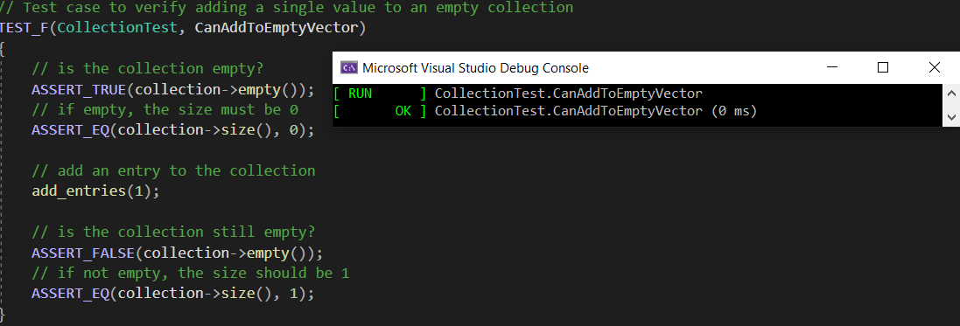
Can Add To Empty Vector

Slide 9
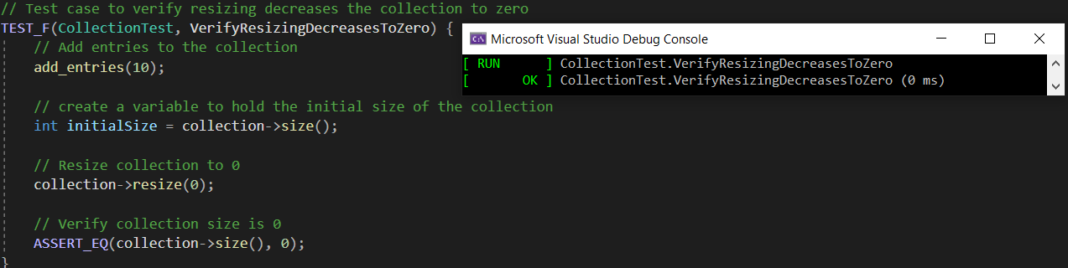
Verify Resizing Decreases To Zero

Slide 10
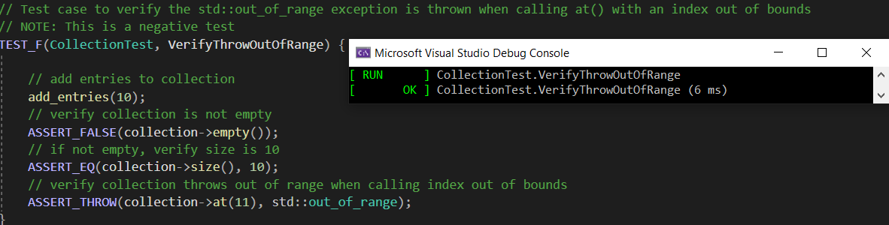
Verify Throw Out Of Range

Slide 11
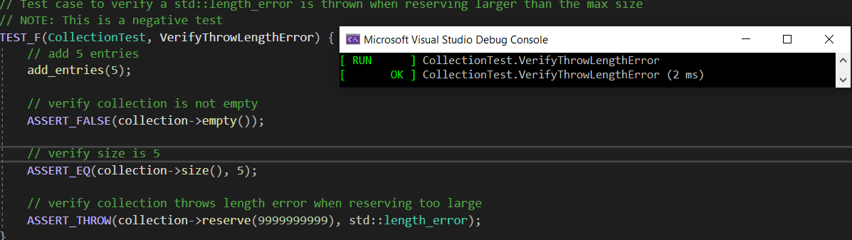
Verify Throw Length Error

Slide 12

AUTOMATION SUMMARY

Slide 13
TOOLS
DevSecOps integrates security throughout the software development lifecycle. DevSecOps involves planning, coding, building, testing, deployment, and monitoring. A few essential tools that can be used are Jira, CppCheck, SonarQube, Jenkins, and Fortify. In addition, external tools like Terraform, Vault, and Splunk will further enhance the infrastructure, container, and log security. This approach will help automate processes, reduce vulnerabilities, and ensure industry compliance.

Slide 14
RISKS AND BENEFITS
Risk of waiting:
Expensive, time-consuming repairs
Liability risk
Loss of reputation and public trust
Benefits of early action:
Mitigating or preventing any possible damage
Add defense in depth layers to reduce risk
Reduce liability
Increase reputation and public trust
Find and eliminate any possible risks before someone else does

Slide 15
RECOMMENDATIONS
Automated Security Testing:
Enhance development pipeline with comprehensive tools like Veracode.
Detect vulnerabilities early, reducing the risk of security breaches.
Incident Response Plan Refinement:
Learn from real-world incidents such as the Experian data breach.
Refine the plan for increased effectiveness in response strategies.

Slide 16
CONCLUSIONS
ISO/IEC 27001 Adoption:
A Systematic approach for managing sensitive information.
Ensure data confidentiality, integrity, and reliability.
Zero Trust Security Model:
Implement multi-factor authentication.
Proactive Incident Response:
Refine plans based on real-world incidents for better adaptability.
Continuous Education and Training:
Regularly educate personnel on the latest security threats.

Slide 17
REFERENCES
BlackRockEngineering. (2022, January 4). Automation in C++ - BlackRock Engineering. Medium. https://engineering.blackrock.com/automation-in-c-6f9666bbb3f7
Kirsh, A. (2022, August 16). Top 10 secure C++ coding practices - Incredibuild. Incredibuild. https://www.incredibuild.com/blog/top-10-secure-c-coding-practices
Muncaster, P. (2020, August 20). Experian data breach hits estimated 24 million customers. Infosecurity Magazine. https://www.infosecurity-magazine.com/news/experian-data-breach-24-million/
Secure Coding in C++11 and C++14. (2016, September 26). SEI Blog. https://insights.sei.cmu.edu/blog/secure-coding-in-c11-and-c14/
Team, A. C. (2018, April 4). Defensive programming with new C++ standards – CppDepend: https://cppdepend.com/blog/defensive-programming-with-new-c-standards/

